Slide 1
Housing Affordability
How has housing affordability changed from 2009-2018?

Slide 2
Team Webcam Warriors
Team Members
Erin Lee
Jake Geiser
Katy Luquire
Bert Kennedy

Slide 3
Analysis Questions
How has affordability changed from 2009 to 2018?
Is it different depending on your age and race?
Which southeastern states are more affordable?

Slide 4
Background
What is affordability?
We define affordability as the ratio of Total Property cost/Income.
Where is our data from?
Our data is provided the Federal Housing Finance Agency. The data sets we used are the public use Federal Home Loan Bank datasets.

Slide 5
Data Cleaning
Started with 9 sets of 82 columns
Reduced to 9 sets of 16 columns - Demographic and Mortgage information
Only kept NC data
Check the data for our questions
Scope of question was too narrow
Add other states
Merge the sets together

Slide 6


Data Merging
Used the pandas concat function to stack datasets with the same column names
One column was named differently(name1, Name1, name 1)

Slide 7
How has affordability changed from 2009 to 2018?

Slide 8
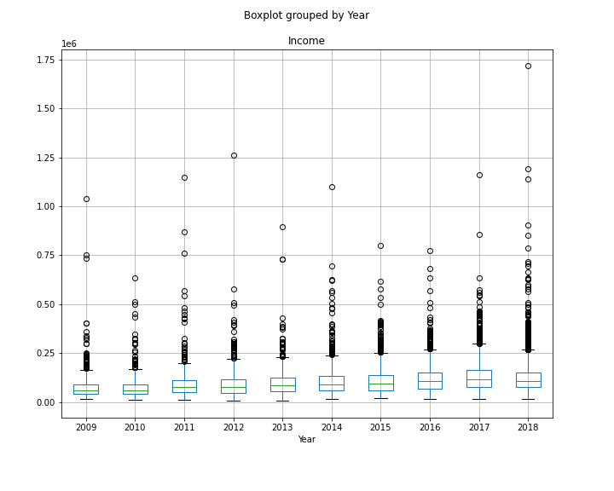
Overall Income
Very little growth in income since 2009.
The minimum income rate has remained stagnant.
Income growth has happened for higher earners.

Slide 9
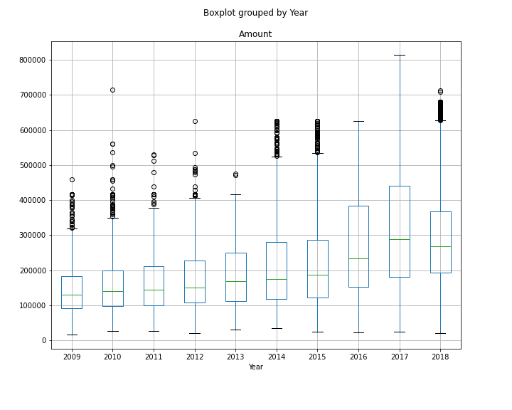
Overall Amount
Median home prices increased annually (aside from 2018) despite the housing crash in 2009.
2015-2017 saw the greatest increase in median home values.

Slide 10
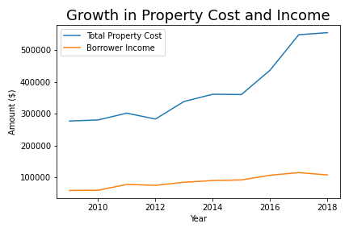
Overall Trend
Total property cost rises at a significantly higher rate than income.
Incomes have remained relatively flat since 2009.
This chart is displaying median Total Property Cost and median Incomes.

Slide 11
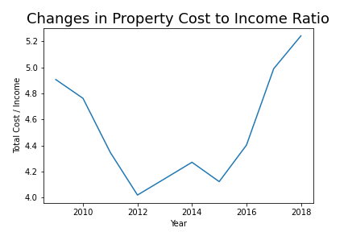
The Ratio
Total cost is defined as the interest rate, amount and term of loan( 30 years).
Since the housing crash from 2008 to the low of 2012, housing costs as it relates to income has risen higher than pre-crash costs.
This increase is a combination of stagnant wages and increased property cost.

Slide 12
Is housing affordability different depending on your age and race?

Slide 13
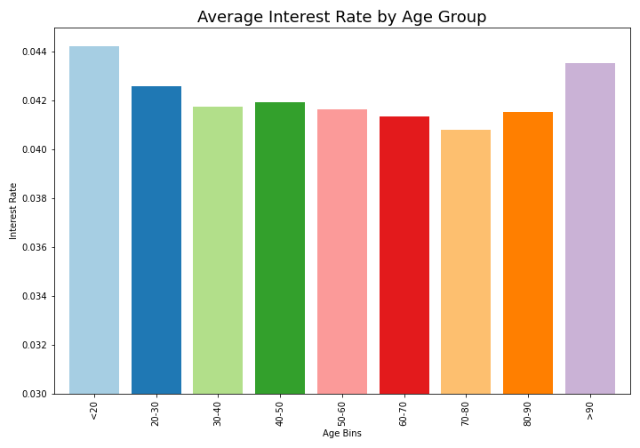
Age Group Interest Rate
There is a noticeable change in mortgage interest rate which can affect affordability depending on your age.

Slide 14
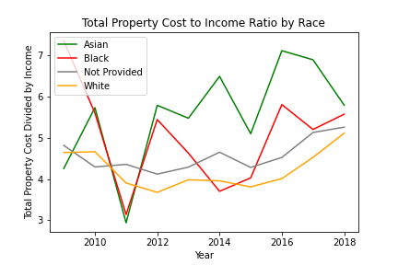
Total Cost to Income Ratio by Race
All demographics in recent years seem to be increasing the amount of their income that they spend on housing

Slide 15
Which Southeastern states are more affordable?

Slide 16
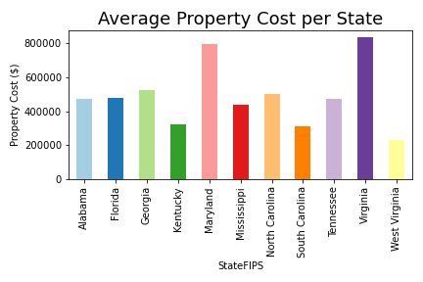
Avg. Property Cost per State
Virginia and Maryland have a significantly higher property cost than the other states.
West Virginia has the lowest property cost out of all the states.

Slide 17
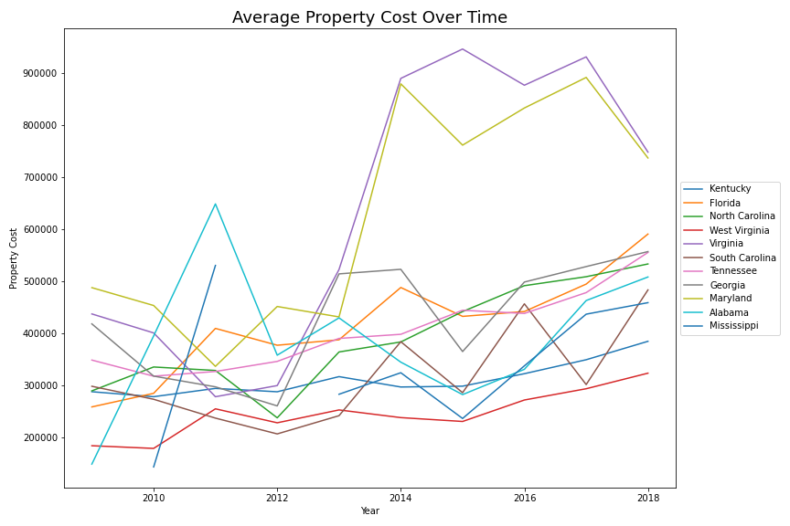
Avg. Property Cost Over Time
All states show a rise in total cost of owning a home since 2009.

Slide 18
Conclusion
Housing costs have risen since 2009 while incomes have remained relatively flat. This could infer that owning a home has become less affordable.
Based on your age, your interest rate can vary. Interest rates are higher for younger borrowers and steadily decline as the borrower ages. However, they begin to increase again at age 80 and above.
West Virginia, Kentucky and South Carolina have the most affordable housing costs throughout the southeast.

